Slide 1
Pegasys 7.1.2 Upgrade General Training
March 2015

Slide 2
Table of Contents
Segment 1: Pegasys 7.1.2 Overview Slide 3
Segment 2: General System Enhancements Slide 6
Segment 3: Automated Disbursements Enhancements Slide 19
Segment 4: Workflow Enhancements Slide 21
Segment 5: Budget Execution Enhancements Slide 27
Segment 6: Credit Card Enhancements Slide 29
Segment 7: Purchasing Enhancements Slide 35
Segment 8: Reference Enhancements Slide 38
Segment 9: Security Enhancements Slide 40
Segment 10: Additional Items Slide 43
Notes:
20 Enhancements in General Training

Slide 3
Segment 1:
Pegasys 7.1.2 Upgrade Overview

Slide 4
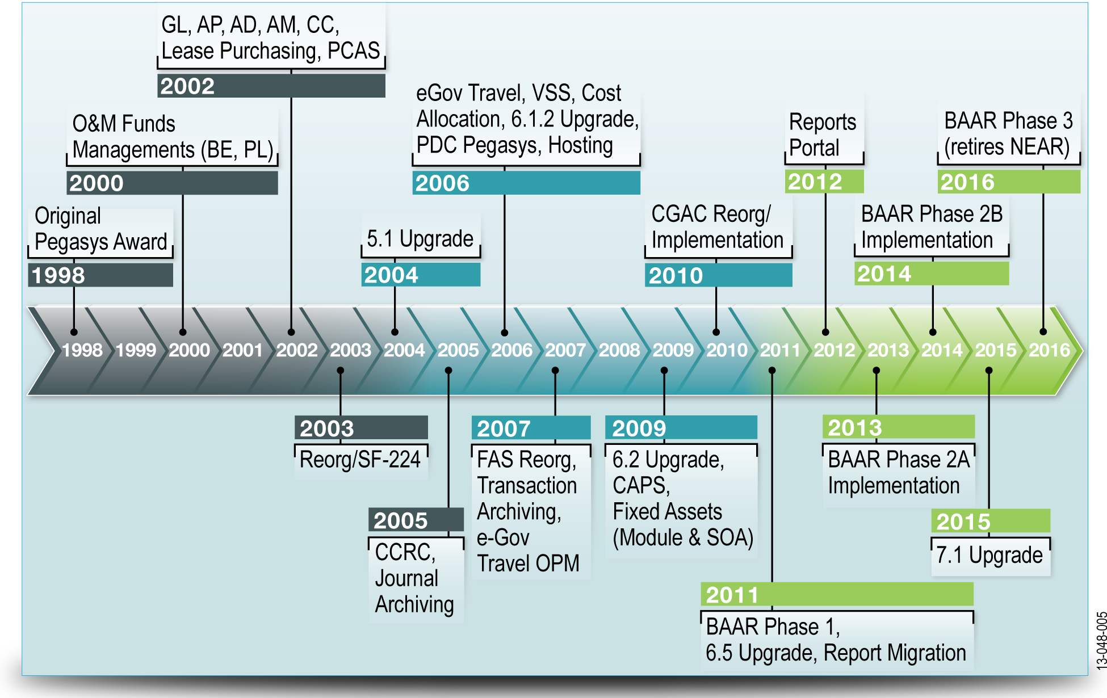
Pegasys History
Pegasys
GSA’s financial system of record delivering comprehensive, federal-specific financial management automation.

Slide 5
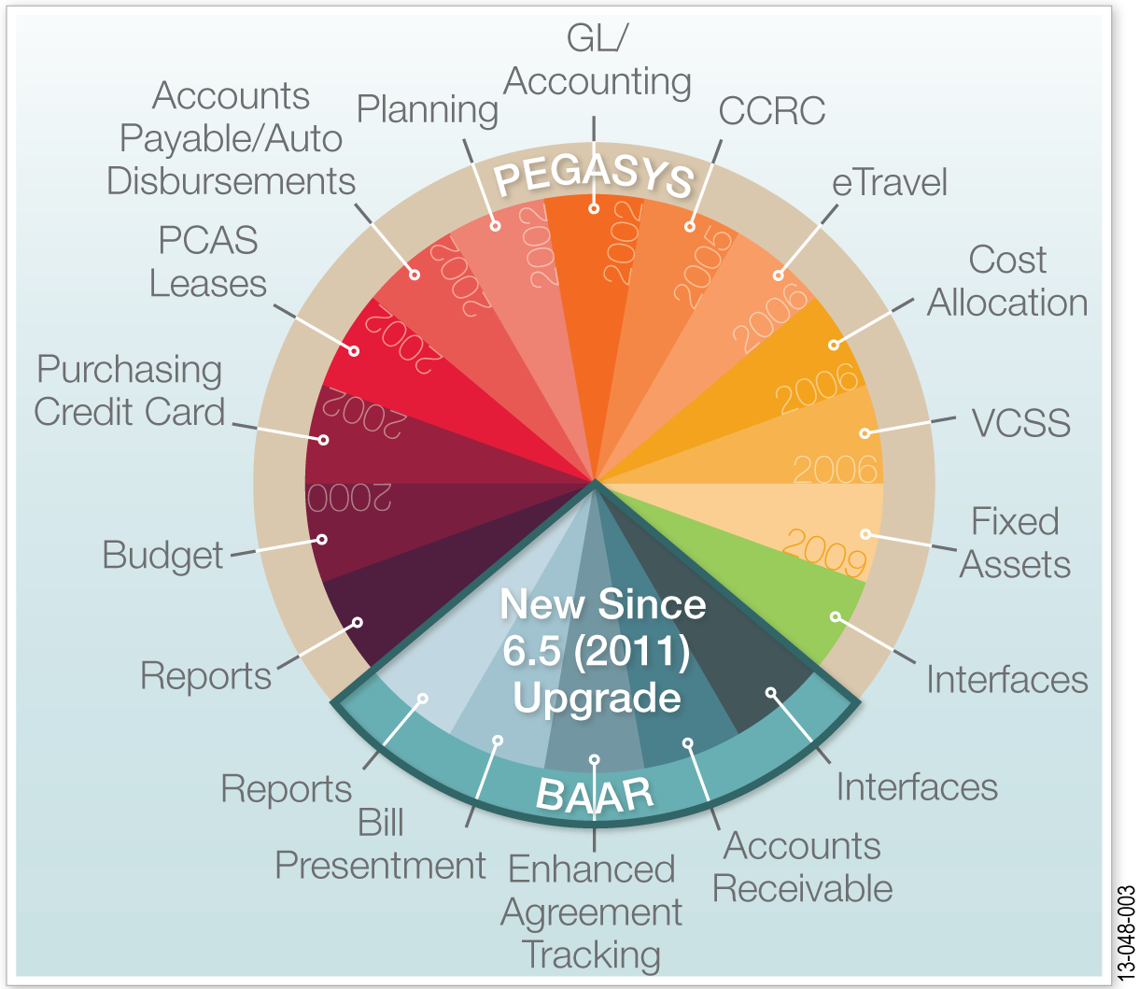
7.1.2 Upgrade
7.1.2 Upgrade
Incorporates enhancements selected out of160 new features designed to meet current legislative and government-mandated federal financial management requirements and recommendations.
Pegasys Subsystems
List of Subsystems
Accounts Payable
Accounts Receivable
Automated Disbursement
Budget Execution
Credit Card
Fixed Assets
Project Cost Accounting
Purchasing
Travel Accounting
General Systems
Lease/Recurring Services
Reporting
Notes:
Speaker Note: We are not implementing all 160 enhancements, only chosen GSA enhancements.
Speaker Note: As we discuss these General Enhancements, we will highlight front end user impact vs. backend user impact.

Slide 6
Segment 2:
General System Enhancements

Slide 7
Modified Display of the Reference Query
Reference Query
The Reference query (also known as the Reference Tree) provides the ability to view all transactions that reference and are referenced by a particular transaction.
Available at the document level, the accounting line level, and the itemized line level.
Shown in a tree format with expandable groups containing the Referenced transactions and the Referencing transactions.
Also displays documents even if they do not have references.
Enhancement Overview
Display Updates:
Additional information is available from the tree section without requiring users to have to select individual records to view details.
New Fields: added to tree
System Date, Invoice Number, Invoice Date, Contract fields
New export capabilities
Can be exported to a comma delimited (CSV) file.

Slide 8
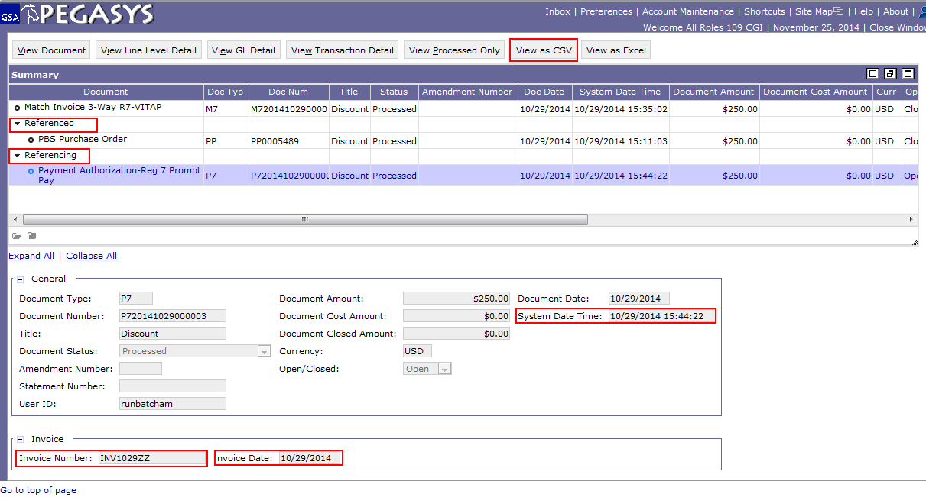
Modified Display of the Reference Query
Notes:
Presenter Note: Look up both M7201410290000 Invoice to show Referenced/Referencing feature as well as Purchase Order PP0005489 as suggested by Functional Coordinator.

Slide 9
Add Attachments to Notebooks & Queries
Business Process Overview
Extends the Attachment functionality to various notebooks and queries increasing the ability to add pertinent user information within Pegasys.
Allows users to view and manage attachments at notebook and query level.
Will no longer require navigation to the form/document level to add an attachment.
7.1.2 Enhancement
Users can access the Attachment page via the Attachments button on the Notebook or Query.
Attachment can be classified as "attachments" or "supporting documentation" and can be protected by using the "Sensitive Attachment" functionality.
Users with permissions to view Query can view attachment unless attachment is marked Sensitive.
If an attachment is marked sensitive, the user who marked it sensitive can assign other users who can view, edit and delete.
Attachments associated with forms/documents are processed separately will not be visible from the Notebooks or Queries; and vice versa.
Notes:
Speaker Note: Consistent with other Pegasys attachment functionality, special characters are still not allowed for attachment file names.
Speaker Note: Documents must still be Processed for Documents to be on Queries.

Slide 10
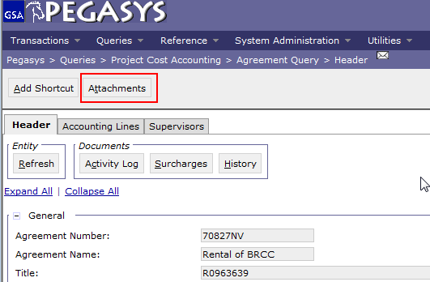
Add Attachments to Notebooks & Queries
Queries Impacted:
Agreement Query
Blanket Agreement Query
Contract Query
Project Notebook/Query
Initiative Notebook/Query
Planning Notebook/Query
Credit Card Statement Reconciliation Notebook
Document Level Reorganization Notebook
Global Level Reorganization Notebook
Supported File Extensions:
doc, docx
xls, xlsx
txt
ppt, pptx
pdf
bmp
wmf
MIME
jpeg
jpg
jpe
gif
png
Notes:
MIME files- application/octet-stream

Slide 11
Modify Prevent New Spending Logic
The Prevent New Spending/Prevent New Use (PNS/PNU) logic:
Identifies transactions with a document reference and flags new transactions for any increase of amount at a line level.
Forces a check at the new document’s line level to ensure:
The processed amount is less than or equal to the referenced document's outstanding amount, and
The referenced document's Vendor, or Fund, or Dimension are a match to those on the new transaction.
If Pegasys determines that new spending exists, an overridable error will be issued on the form.
GSA has full customization when granting override permissions.
Overriding the error will permit successful processing of the transaction.
Notes:
The Prevent New Spending logic provides agencies with a robust manner to prevent new activity with Vendors, Funds, or Dimensions. To correctly identify new spending, the system forces a check at the line level to ensure the amount will be less than or equal to the referenced document's outstanding amount, and the referenced document's Vendor, or Fund, or Dimension are a match to those on the new transaction.
The enhancement is the Bypass Prevent New Use/Spending on the document type
Without PNU, GSA could hit a dead-end in a chain and not be able to invoice a transaction for which they have already received an order or receipt

Slide 12
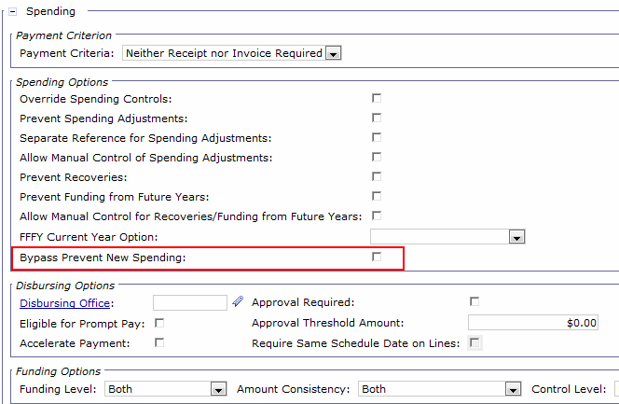
Modify Prevent New Spending Logic
Document Type Reference Table Updates
Bypass Prevent New Spending flag added to Document Type Reference Table.
Reference > Document > Document Types
Allows agencies to configure the Invoice (IV), Matched Invoice (II), and Travel Invoice (TI) without the prevent new spending edits being triggered.
Permits an IV, II, or TI to process using a Vendor, Fund, or Dimension marked PNS/PNU with no error messages displayed.
Notes:
Speaker Note: This is a backend user enhancement. As a result of this enhancement Front end users will see an error. If error is received please contact your functional coordinator.

Slide 13
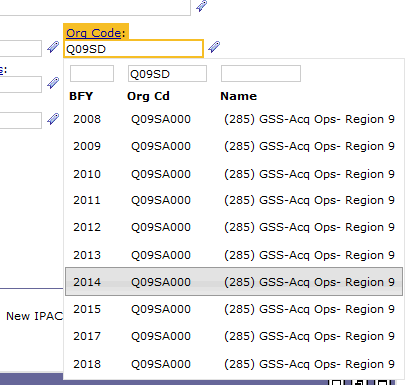
Rich Type Ahead
Provides an optional efficient means of searching for and selecting key reference data by introducing a new type ahead feature on several commonly used reference fields.
Entering text into select reference backed field triggers a dynamic search window, which will display resulting records containing the entered text in that field.
May be disabled under Preferences > Usability Settings > Auto-complete.
Selecting the appropriate record will then populate the necessary reference data.
Notes:
IPAC Transaction Query Short key 00130400- rich type ahead
Speaker Note: Applies to Referenced back data (field names with links).

Slide 14
Sequential Amendment Number Generation Improvement
Pegasys 6.5 functionality:
Allowed GSA to configure different formats for Amendment Number based on Document Category or Document Type and automatically generated the appropriate number when the amendment form is created.
7.1.2 Enhancement Update
The system generated Amendment Number generation logic increments the Amendment Number from the last saved Form rather than from the last generated number.
Amendment numbers can be re-used if it is generated on a created form that is not actually saved, or the form is saved but then deleted.
Manually entered amendment number logic remains the same- if a manually entered form is not saved, or is saved but deleted, the amendment number can be reused.
Notes:
Amend GDN-0018

Slide 15
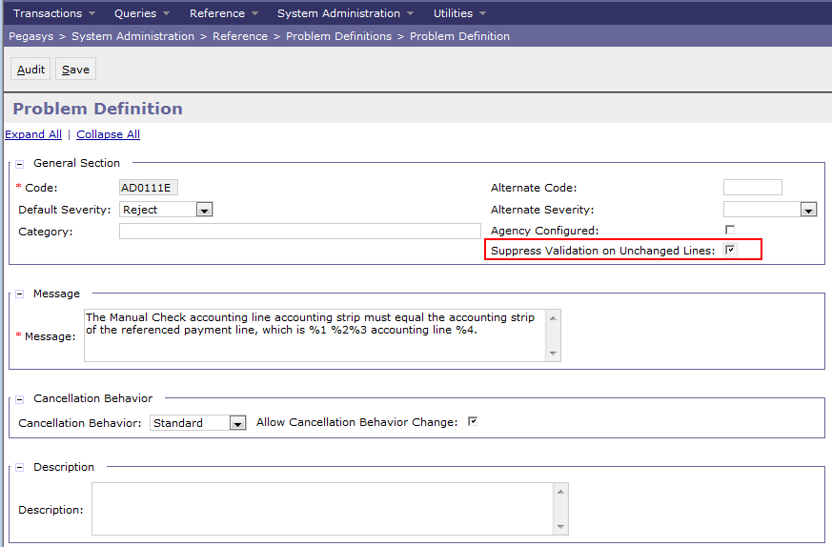
Suppress Validation of Unchanged Lines
7.1.2 Enhancements
Allows bypassing error validations for Header, Accounting, and Itemized lines that have not been changed during a correction or amendment.
Via Batch Job
Via Manual Creation
Reduces the number of errors users need to assess when performing corrections/amendments by automatically filtering out errors not relevant to the action being performed.
Applies only to immaterial
changes, i.e. Text field update,
changes that do not impact
accounting.
Material changes will still
trigger error validation, i.e.
accounting dimensions, dates.
Configured by error code
on Problem Definition
Maintenance table.
Notes:
System Administration > Reference > Problem Definitions > AD0003E

Slide 16
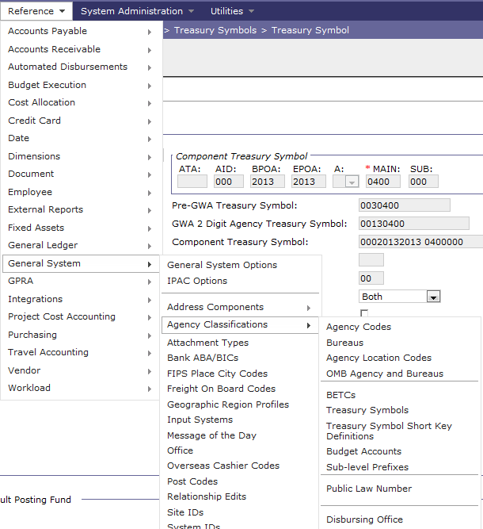
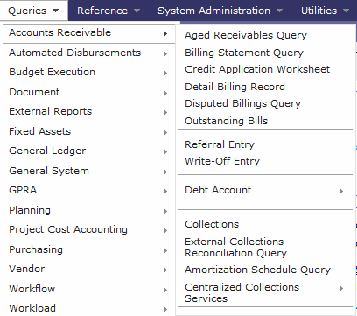
User Interface Improvements for Menus
7.1.2 Enhancement
Grouping items more logically and using submenus more often.

Slide 17
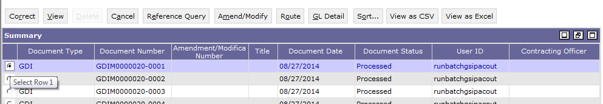
User Interface Improvements for Result Sets
7.1.2 Enhancement
New feature-rich style of presenting a collection of results (Item Collection)
Includes the ability to:
Move and resize columns.
Sort search results based on multiple columns.
Arrange in sequence.
View a larger volume of results.
View search results in CSV so that search results may be exported externally to such applications as Microsoft Excel.
Notes:
Speaker Note: Show the dragging features of item collection. Show number displayed moved to bottom.
Speaker Note: Rearranged Columns will not be captured in the CSV export.

Slide 18
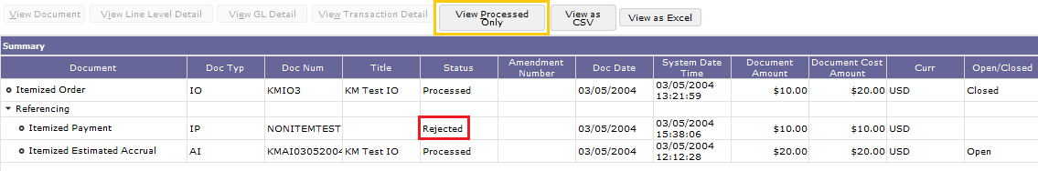
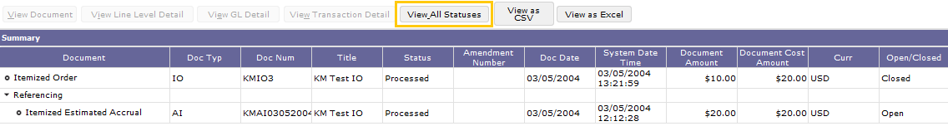
View Unprocessed Transactions Added to the Reference Query
7.1.2 Enhancement
Provides GSA with the ability to view both Processed and non - Processed transactions in the Reference Query.
Reference Tree displays both a Processed transaction and non- Processed transactions referencing it.
Toggling option displays transactions in all states or only show processed transactions.
View All Statuses
View Processed Only
Notes:
PR200911190033

Slide 19
Segment 3:
Automated Disbursements Enhancements

Slide 20
Early Issue Identification
7.1.2 Enhancement
Implements overrideable edits across multiple reference tables that are invoked during the verification and submission of disbursement transactions.
Reduces common errors that cause dropped disbursement schedules during execution of the Automated Disbursement batch processes.
Edits For Check/Electronic Fund Transfer (EFT) payables:
Ensure there is a “Disbursement In Transit” Accounting Event established on the Transaction Definition maintenance table whenever the disbursing method is set to Treasury Disbursing.
Determine if the line is eligible for Prompt Pay if an entry exists on the Interest, Penalty, and Discount Distribution table for the fund referenced on the transaction.
Ensure that a Schedule Number Template has been established for the anticipated Schedule Number used for the payment during the fiscal year of the disbursement.
Applies existing edits on the Imprest Fund (IF), Itemized Payment (IP), Travel Advance (TN), Third Party Payment Voucher (TP), and Travel Voucher (TV) Document Categories to the Itemized Match Invoice (II) Document Category.

Slide 21
Segment 4:
Workflow Enhancements

Slide 22
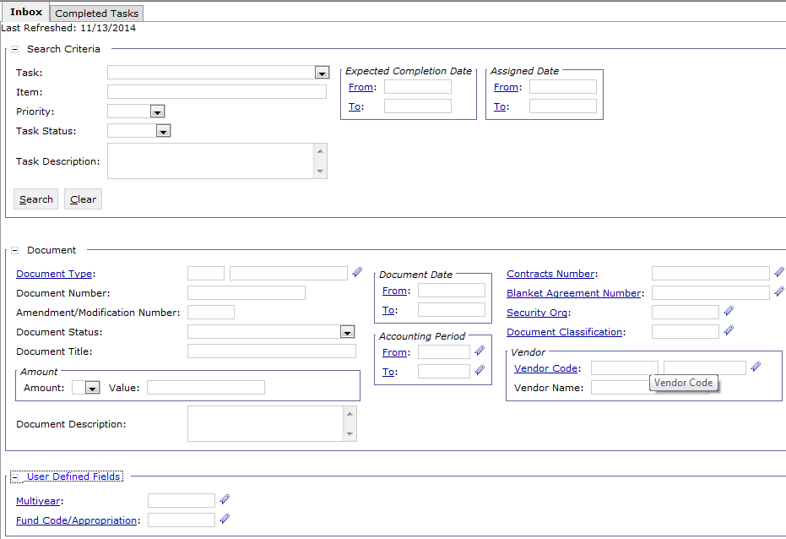
Additional Inbox Fields
7.1.2 Enhancement
Expands Inbox Search Criteria and adds new fields to the Item Collection for the Inbox and Completed Tasks tabs.
Additional Search criteria:
Document Information, Vendor Information, etc.
Notes:
Note: CP is in place to hide certain fields

Slide 23
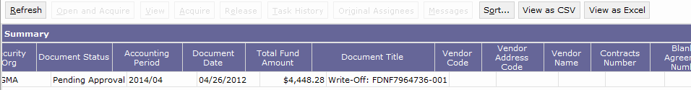
Additional Inbox Fields
Additional Item Collection values
Document Status
Accounting Period
Vendor Name
Vendor Code
Vendor Address Code
Total Funded Amount
Additional values allow users to sort the Inbox tasks by the desired column and quickly determine appropriate task.
Header-level User Defined Fields
Header-level Description Field
Header-level Contract Number/BPA Number
Document Number
Document Title
Document Type
Document Date
Document Classification
Amendment Number
Security Organization

Slide 24
Task Email Notification
Inbox Functionality Overview:
The Pegasys Inbox allows users to manage tasks, work assignments, and approve work.
Upon defined document processing, workflow functionality sends email notifications for the various tasks, informing the appropriate users that tasks are available for their review.
7.1.2 Enhancement
Provides more extensive email notification content configuration.
Establishes a URL link within the email notification that leads to the actual task as opposed to the inbox.
For users with Single Sign-On (SSO):
Link will take the user directly to the task itself in the View Mode rather than to the Pegasys Inbox.
For users without SSO:
URL will take user to Pegasys sign in page before they are taken to the View Mode.
From the View Mode the user may review and acquire the task in order to complete it.
Extends the new logic to supported tasks for mobile applications.

Slide 25
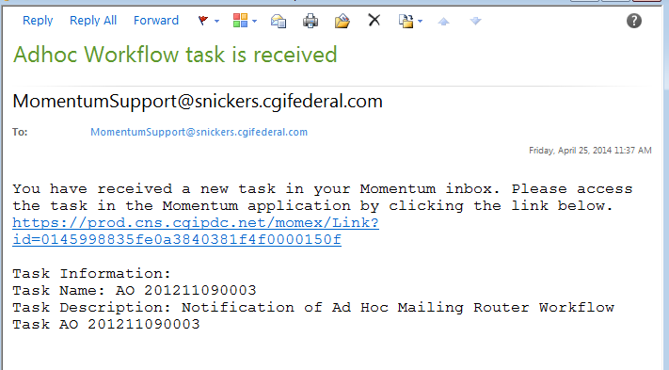
Task Email Notification

Slide 26
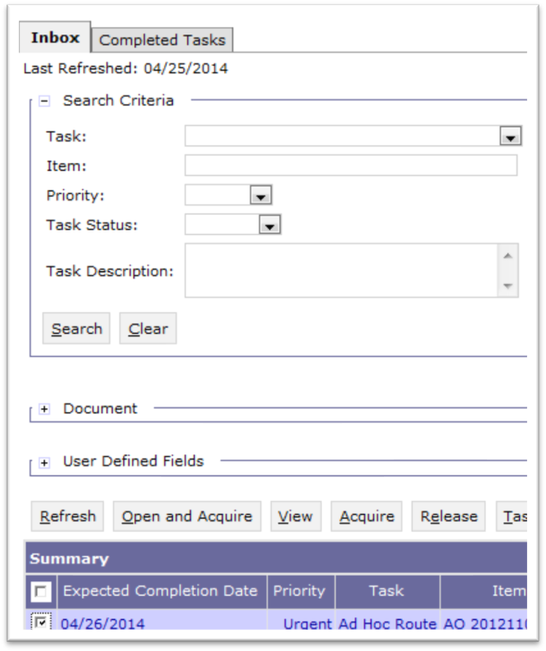
Workflow: View Workflow Tasks without Acquiring
7.1.2 Enhancement
Provides the ability for a user to view an inbox task without acquiring it.
Users can review detailed task information before acquiring it and removing the task from the inboxes of other assignees.
Provides the ability for a user to acquire and complete the task that is being viewed without having to return to the Inbox.

Slide 27
Segment 5:
Budget Execution Enhancements

Slide 28
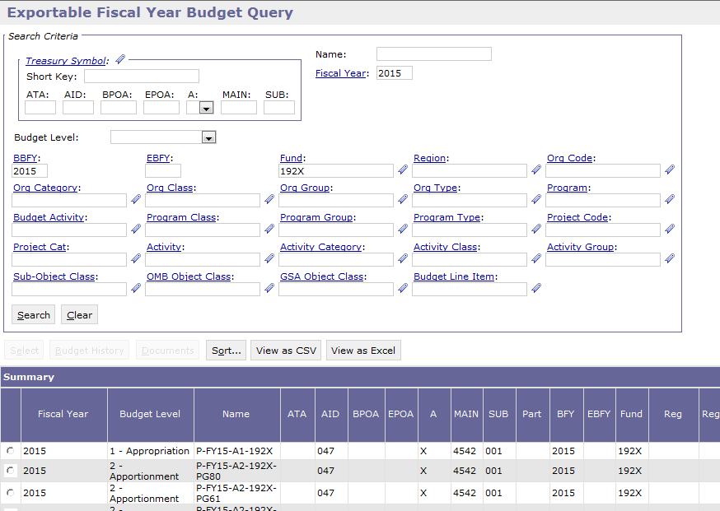
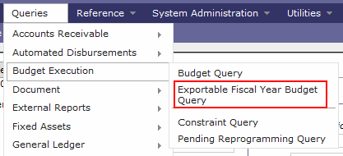
Exportable Fiscal Year Budget Query
7.1.2 Enhancement
New query displays the budget data summarized by fiscal year without first requiring the user to select and view the data at the summary budget node level.
Provides users the ability to view multiple budget nodes data in a single query window.
Notes:
Queries > budget execution > Exportable Fiscal year query
Name: P-FY15-A2-192X
Year: 2015

Slide 29
Segment 6:
Credit Card Enhancements

Slide 30
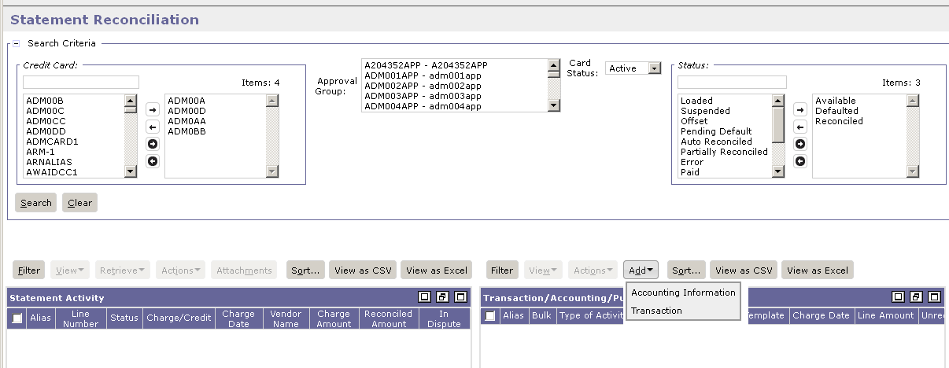
Credit Card Statement Reconciliation Notebook
7.1.2. Functionality
Credit Card Statement Reconciliation Notebook Updates
Provides ability to reconcile transactions that do not reference a credit card via the Add Transaction functionality.
Enables cardholders to reconcile credit card charges and credits to any transaction that was paid for with a credit card.
Including charges where the credit card alias was inadvertently left off of the credit card order at the time the transaction was entered into Pegasys.
No longer required to correct or amend the transaction prior to reconciliation for the sole purpose of adding the credit card alias.
Notes:
The reconciliation notebook holds all the information related to credit card statement lines. It allows users to see every credit card statement line and the status of that statement line. Users primarily use the reconciliation notebook to reconcile credit card statement lines to a CL (credit card log)/CT (credit card training log) Order document (also called credit card log) or accounting strip to create GL impact.
Users’ credit card statement lines get loaded into this notebook by batch job. In 6.5, users have to create either an order doc (CL/CT) out of notebook or associate to Accounting strip. On the CL/CT document they had to reference the Credit Card alias on the document in order for the document to show up in the reconciliation notebook. If they forgot to include the Credit Card Alias, they had to amend or correct the document prior to reconciliation for the sole purpose of adding the credit card number. Otherwise the CL/CT document would not show up on the reconciliation notebook.
Now, they can hit Add transaction to select the CL, and the credit card Alias would automatically be added onto the CL order document.
Add Accounting Strip- will make sure money is allocated. Associating to Accounting Information will cause GL impact.

Slide 31
Credit Card Statement Reconciliation Notebook
Credit Card Reconciliation Notebook Updates cont.
Cardholder may now offset the charge and credit directly on the reconciliation notebook .
Occurs if a charge and credit cancelling each other out are received from the bank prior to any payment to the bank being issued or reconciliation being performed.
Prevents the need for reconciling both statement lines in a single action.
More user-friendly platform
User can add/remove several or all credit cards and card statuses as search items rather than highlighting and selecting each one.
New Credit Card Alias Shuttle Box displays a list of selectable aliases where the user is an authorized user of the corresponding cards. Comprised of the following buttons:
Add All - moves all aliases in the Alias Selection box to the Alias Selected box.
Remove All - moves all aliases from the Alias Selected box to the Alias Selection box.
Add (Single selection) - moves the selected alias(es) from the Available Aliases list box to the Selected Aliases list box.
Remove (Single selection) - moves the selected alias(es) from the Alias Selected box to the Alias Selection box.

Slide 32
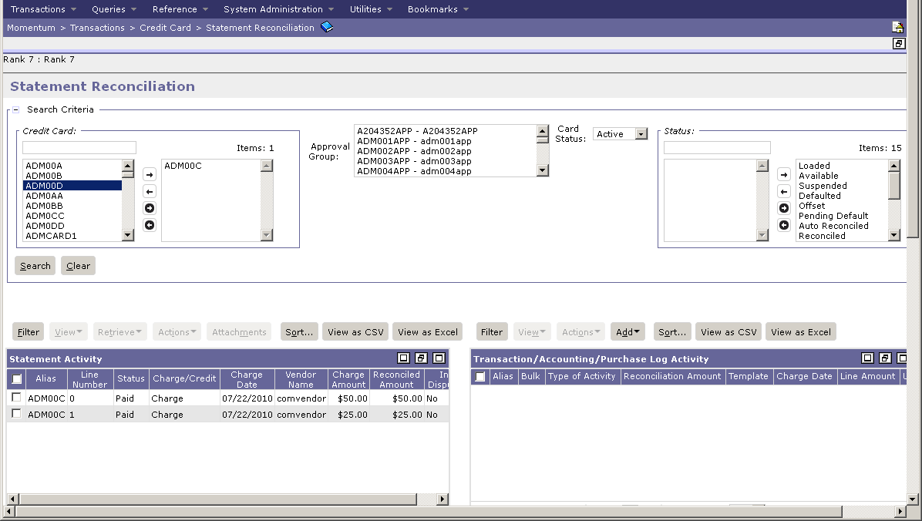
Credit Card Statement Reconciliation Notebook

Slide 33
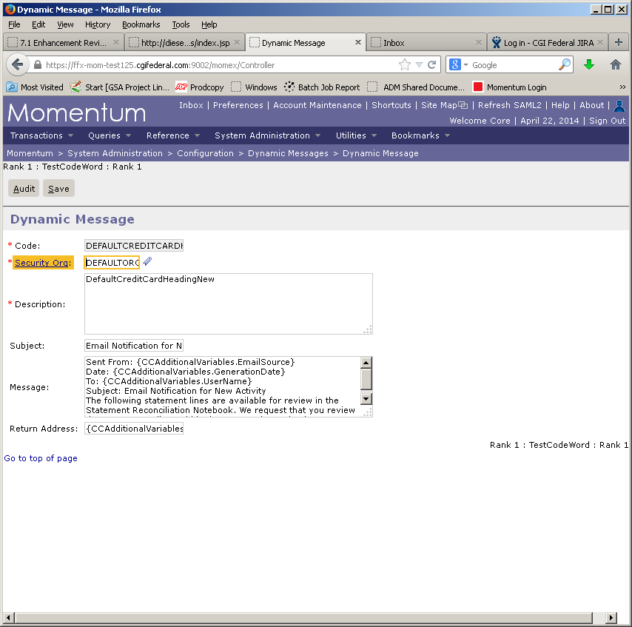
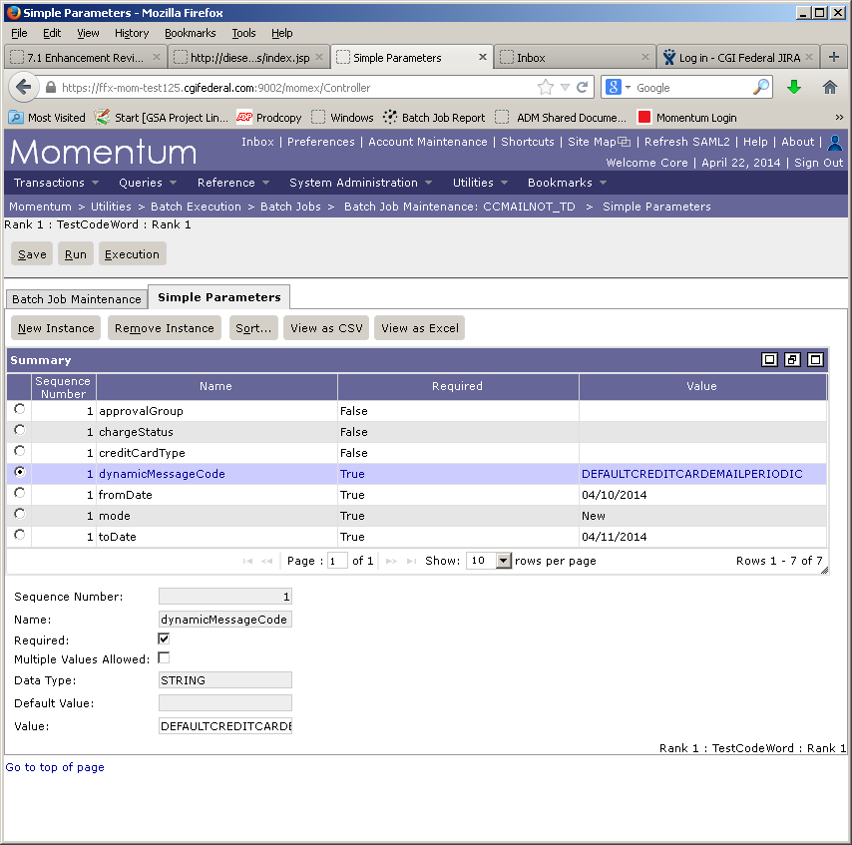
Credit Card Email Notification Batch Job
NEMAILNOTE batch process updates:
Ability to configure email text and insert card or statement-level information into emails generated.
Can add variable message inserts for accounting dimensions, statement line statuses, credit card related data, credit card type related data, charge information, vendor information, reconciliation related data, and the reconciliation user.
Notes:
Credit Card email notification batch job
Speaker Note: For the Front end user, the change will be that the batch report notification email will be more specific regard types of errors and what changes need to be made.

Slide 34
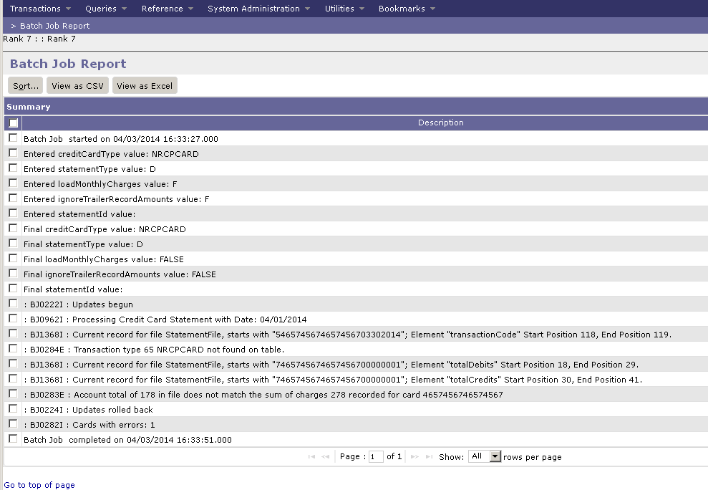
Credit Card Email Notification Batch Job
NEMAILNOTE batch process updates cont.:
Automated reconciliation when no charge date is present on a transaction, and by adding attempted matching between statement line TIN and vendor TIN.
NSEQSTMLOAD error reporting
Reports the start and end date of missing data, which problem definitions are associated with the errors, what data is actually missing.
Identifies invalid data records like credit card type, number, currency code, etc., that are associated with a failed statement load.

Slide 35
Segment 7:
Purchasing Enhancements

Slide 36
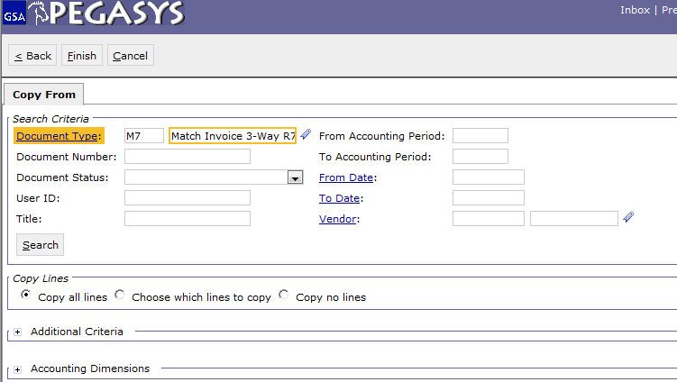
Copying Forward Invoice to Payment Accounts for Additional Reference
7.1.2 Enhancement
Invoice (IV) to Payable (IP) copy forward functionality.
When a user creates a Payment by copying forward an Invoice via 'Copy all Lines', referenced invoice information will be copied over on the Itemized Line in addition to all accounting or funding lines.

Slide 37
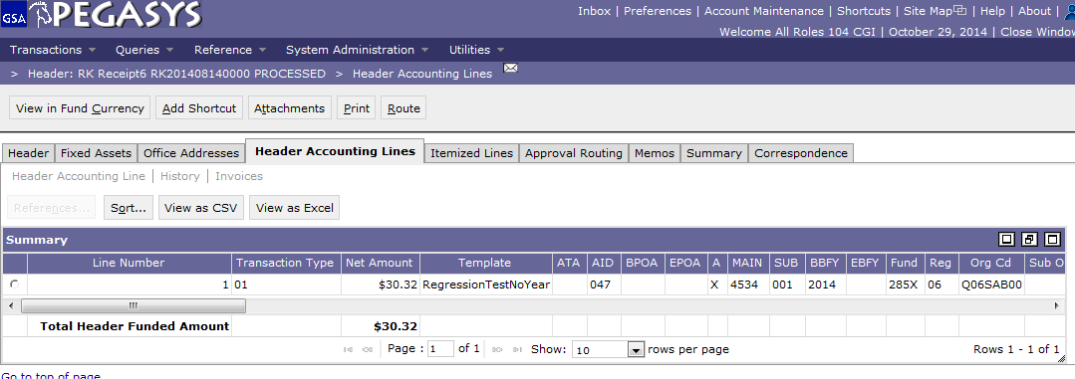
Fund and Cost Total on Lines
7.1.2 Enhancement
The Total Funded Amount and Total Cost Amount is visible for all documents in the Purchasing chain.
The transaction’s Total Header Funded Amount and Total Cost/Itemized Funded Amount are displayed as a summary from:
Header Accounting Lines tabs
Itemized Lines tab
Itemized Accounting Line tab
Allows users to review the impact of all lines of the transaction from a single tab.

Slide 38
Segment 8:
Reference Enhancements

Slide 39
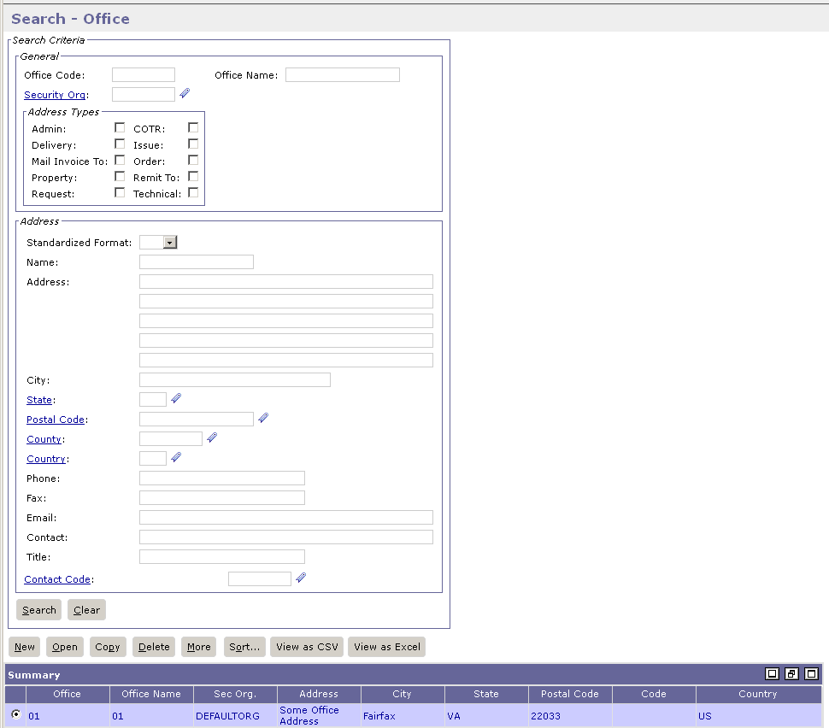
Office Address Usability
7.1.2 Enhancement
Additional options for searching, selecting, and updating addresses entered on the Office Maintenance table are added.

Slide 40
Segment 9:
Security Enhancements

Slide 41
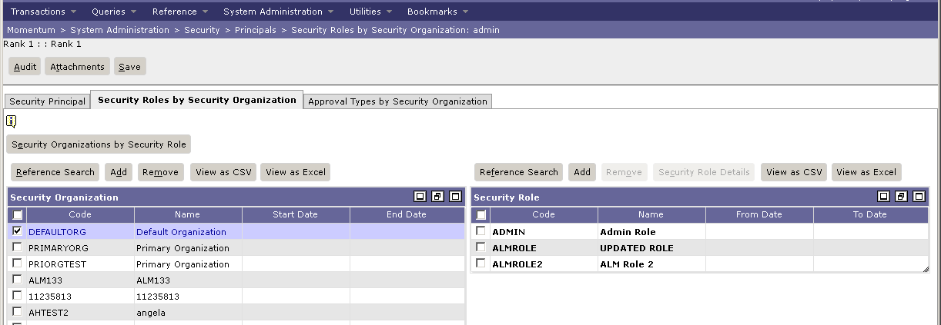
Streamline Organization, Role, and Approval Type Management
7.1.2 Enhancement
Streamlines assigning Security Organizations, Roles, and Approval Types to users in Pegasys and Vendor-Customer Self-Service (VCSS).
Multiple roles may be associated with multiple security organizations in a single action.
Reduces the number of steps required to complete security setup.
Two different views available:
Role by Security Organization view
Security Organization by Role view
Notes:
System Admin > Security > Principals > Security Role by Security Org

Slide 42
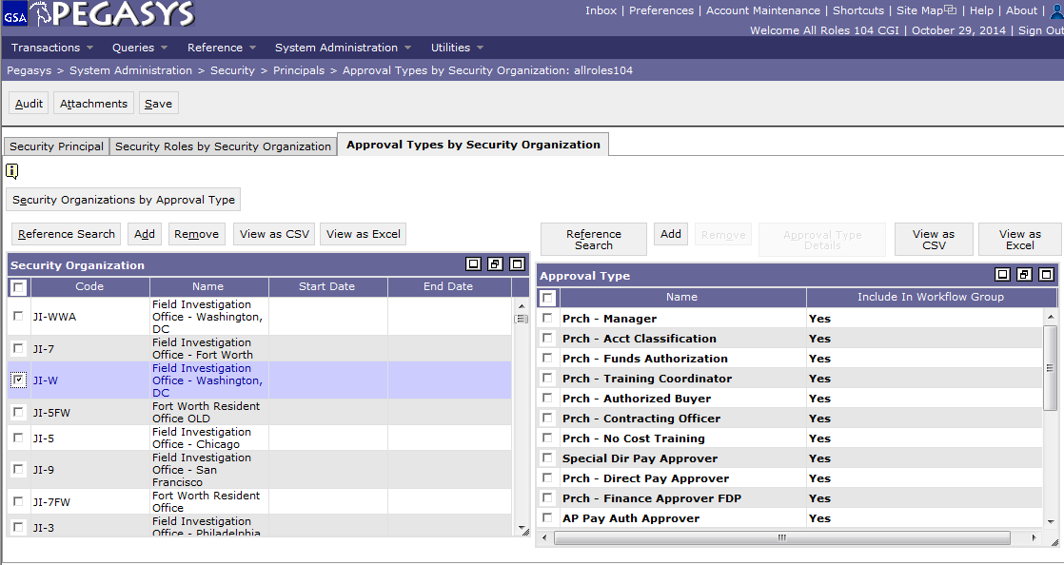
Streamline Organization, Role, and Approval Type Management
Streamlines assigning Security Organizations, Roles, and Approval Types to users in Pegasys and Vendor-Customer Self-Service (VCSS) cont.
Multiple approval types may be associated with multiple security organizations in a single action.
Two different views available:
Approval Type by Security Organization
Security Organization by Approval Type

Slide 43
Segment 10:
Additional Items

Slide 44
Login Confirmation Messages
Blank Rows
Secured Field Searching
Identity Provider (IdP) tabs
Setting Up Security Questions

Slide 45
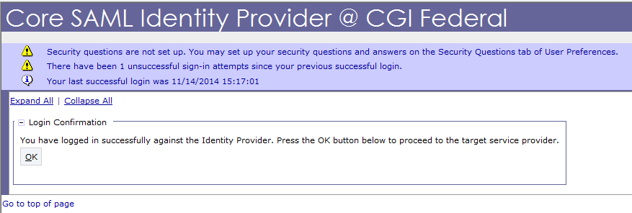
Login Confirmation Message
Upon Logging into Pegasys, users will receive a Confirmation Message through the Identity Provider (IdP) authenticating the user.
Warning Message if Security Questions are not set up.
Warning Message for unsuccessful login attempts.
Time and Date of last successful login.
Users must click OK to get to Pegasys Inbox.
Notes:
Speaker Note: Once a user successfully sets up Security Questions, the informational error will not appear.

Slide 46
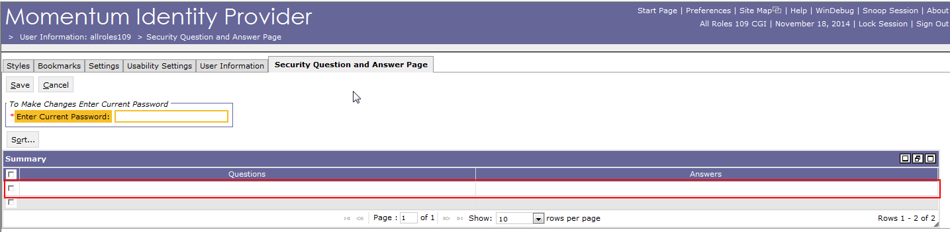
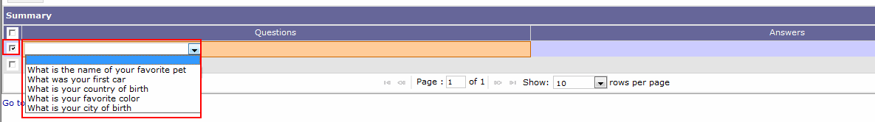
Blank Rows
For rows that are blank, the user needs to select the row and then click in the cell to add information or for a drop down menu to appear.
Blank rows may be automatically defaulted.
On some screens, blank rows appear upon hitting the “Add” button.

Slide 47
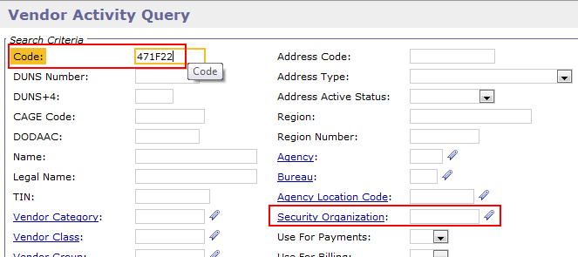
Secured Field Searching
Users searching a secured field (Vendor Code, DUNs, TIN, etc.) no longer need to input a Security Organization.
Secured field permissions are still checked when a user is performing a search on a secured field.

Slide 48
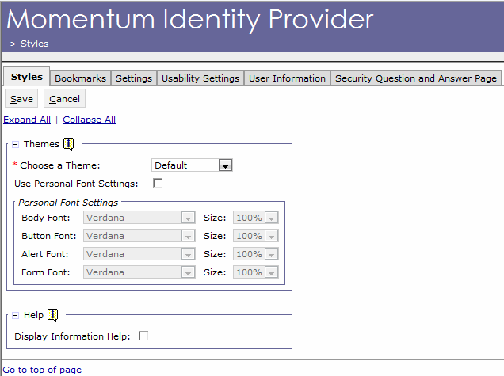
Identity Provider (IdP) tabs
The Momentum Identity Provider (IdP) provides security authentication for the Momentum Suite applications.
Authenticates users prior to logging into Pegasys rather than through the Pegasys application itself.
Selecting Account Maintenance in Pegasys will bring users to the IdP.

Slide 49
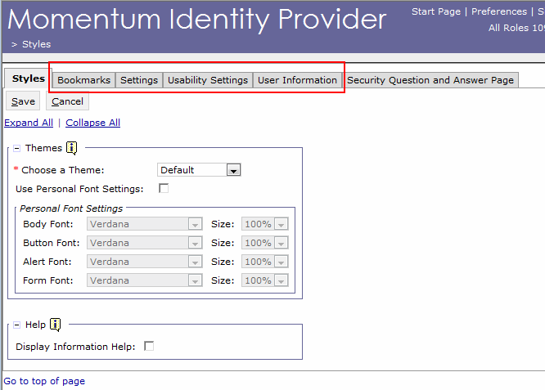
Identity Provider (IdP) Tabs
Preference tabs within IDP update IDP only and not Pegasys.

Slide 50
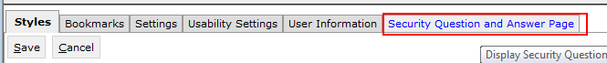
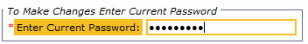
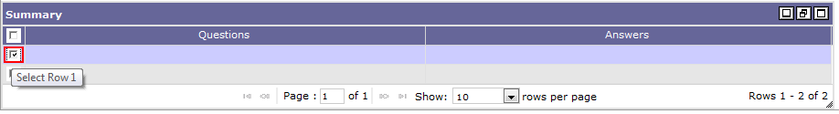
Setting Up Security Questions
Security Questions have been moved to the IdP:
Hit Account Maintenance in Pegasys.
Select the Security Question and Answer Page tab.
Enter your current password.
In the Summary group box, select row.
Cont. on next slide
Notes:
Speaker Notes- Users will not have to set new security questions and answers after 7.1.2 goes live.

Slide 51
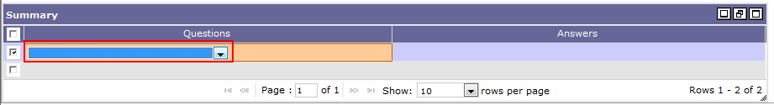
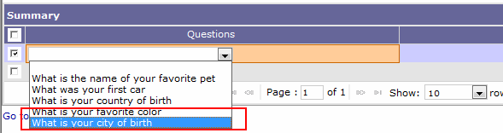
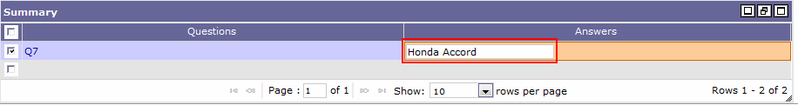
Setting Up Security Questions cont.
Click within Questions row to reveal drop down.
Select security question.
Click Answers row and type answer.
Cont. on next slide

Slide 52
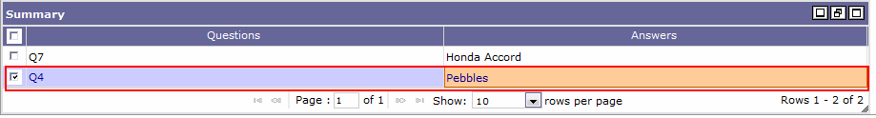
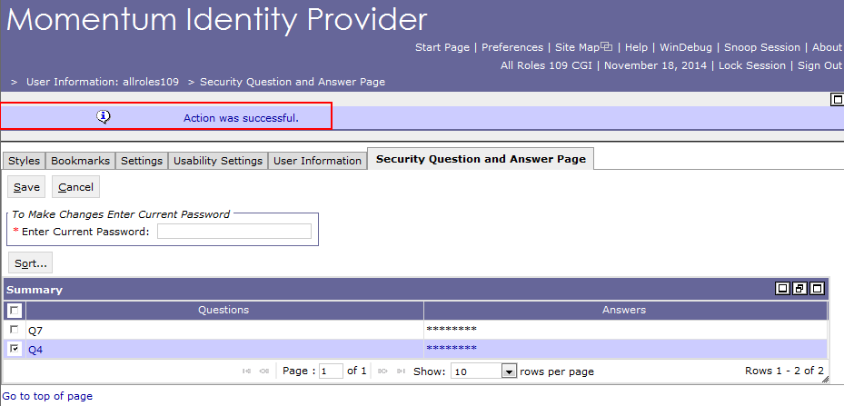
Setting Up Security Questions cont.
Repeat with following row.
Select Save.
“Action was Successful.” message will appear.

Slide 53
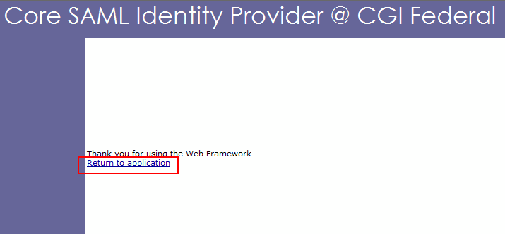
IdP Return to Pegasys
Signing out of IdP system only applies to the IdP system.
The return to application link after signing out is for IdP system.
Close the window and Pegasys system behind IdP will display.

Slide 54

Questions

